Slide 1
BUILDING YOUR FIRST NEURAL NETWORK
https://github.com/mohanrajendran/NN-Presentation

Slide 2
AGENDA
Re-cap of machine learning
Neural networks overview
Training NOT function
Training AND function
Training XOR function
Training a digit classifier

Slide 3
MACHINE LEARNING
Definition
“A computer program is said to learn from experience E with respect to some class of tasks T and performance measure P if its performance at tasks in T, as measured by P, improves with experience E.”
- Tom M. Mitchell
Examples
Task T | Performance Measure P | Experience E
Optical character recognition | Fraction of characters accurately recognized | Training on labeled characters
Spam filtering | Accurately tagging spam and not tagging non-spam | Training on emails labelled as spam/non-spam

Slide 4
NEURAL NETWORKS
Systems inspired by the biological brain
Represented by neurons connected together in a network
Signals are propagated along connections
Learns by adjusting the strength of connections between neurons
Can be used in many different domains

Slide 5
NEURAL NETWORKS
Neurons
Building blocks of biological brains
Takes inputs from multiple neurons and produces single output
Adjusting connection strengths and connecting to different neurons help us learn

Slide 6
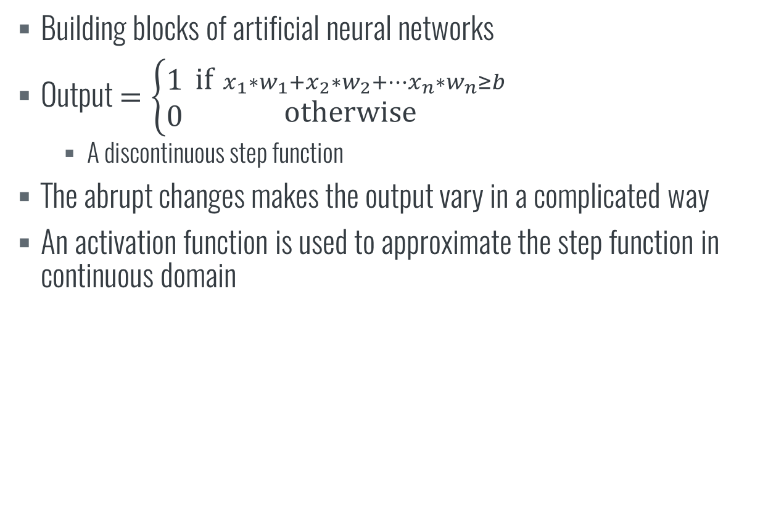
NEURAL NETWORKS
Artificial Neurons
Building blocks of artificial neural networks
Output $=\left\{\begin{aligned}1 \\ 0\end{aligned}\right. {\text{if} { x}_{1}∗w_{1}+x_{2}∗w_{2}+…x_{n}∗w_{n}≥b \atop \text{otherwise}}$
A discontinuous step function
The abrupt changes makes the output vary in a complicated way
An activation function is used to approximate the step function in continuous domain

Slide 7
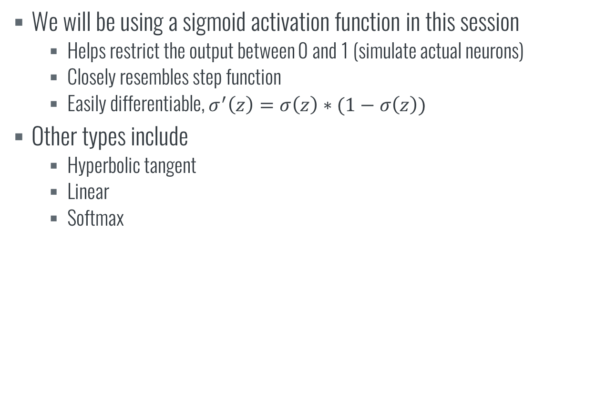
NEURAL NETWORKS
Activation function
We will be using a sigmoid activation function in this session
Helps restrict the output between 0 and 1 (simulate actual neurons)
Closely resembles step function
Easily differentiable, $σ^{′}\left(z\right)=σ\left(z\right)∗(1−σ\left(z\right))$
Other types include
Hyperbolic tangent
Linear
Softmax

Slide 8
NEURAL NETWORKS
Training
By training a neural network, we aim to compute a set of weights and biases that gives the output we want
Achieved using a technique called gradient descent.
Start with a set of weights and bias
Feed forward to compute output
Formulate cost in terms of difference between expected output and obtained
Change weights and bias in direction that reduce cost

Slide 9
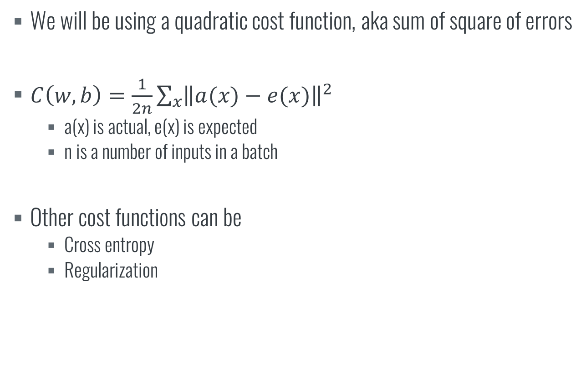
NEURAL NETWORKS
Cost function
We will be using a quadratic cost function, aka sum of square of errors
$C\left(w,b\right)=\frac{1}{2n}\sum_{x}{{\left\|a(x)−e(x)\right\|}^{2}}$
a(x) is actual, e(x) is expected
n is a number of inputs in a batch
Other cost functions can be
Cross entropy
Regularization

Slide 10
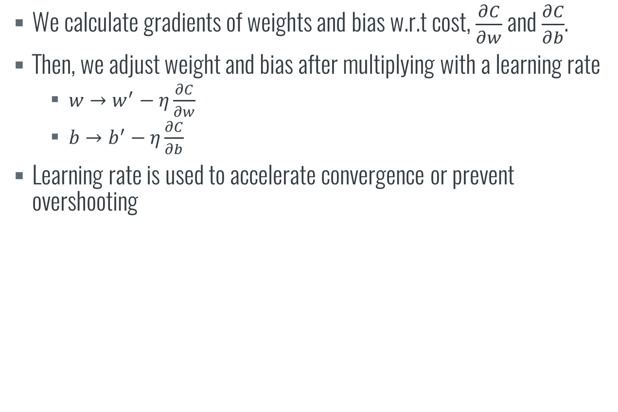
NEURAL NETWORKS
Gradient descent
We calculate gradients of weights and bias w.r.t cost, $\frac{∂C}{∂w}$ and $\frac{∂C}{∂b}$.
Then, we adjust weight and bias after multiplying with a learning rate
$w→w^{′}−η\frac{∂C}{∂w}$
$b→b^{′}−η\frac{∂C}{∂b}$
Learning rate is used to accelerate convergence or prevent overshooting

Slide 11
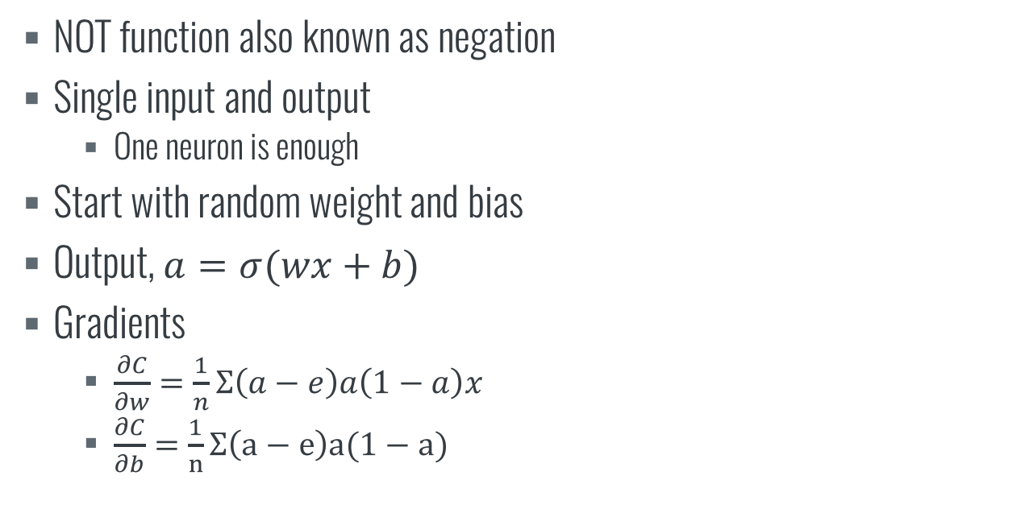
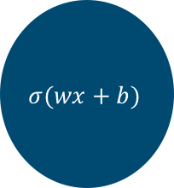
NOT FUNCTION
NOT function also known as negation
Single input and output
One neuron is enough
Start with random weight and bias
Output, $a=σ(wx+b)$
Gradients
$\frac{∂C}{∂w}=\frac{1}{n}Σ\left(a−e\right)a\left(1−a\right)x$
$\frac{∂C}{∂b}=\frac{1}{n}Σ\left(a−e\right)a(1−a)$
$$σ(wx+b)$$
x
a
w
b

Slide 12
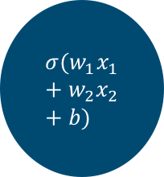
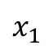
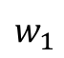
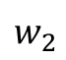
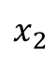
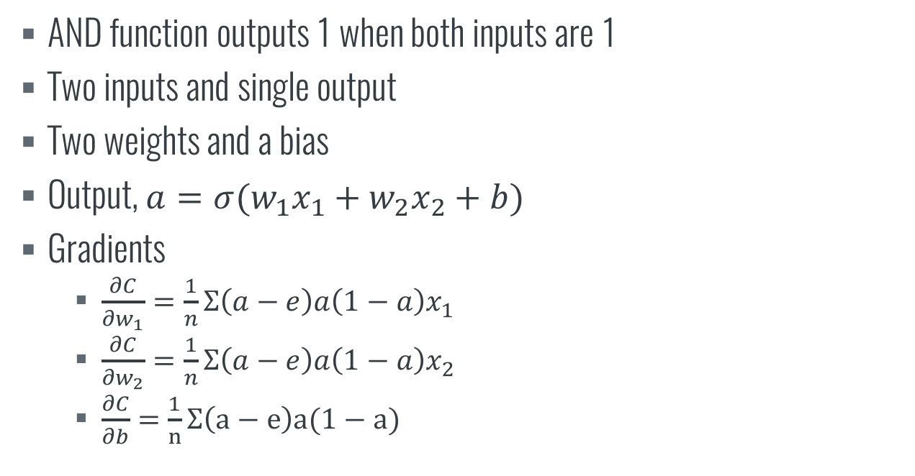
AND FUNCTION
AND function outputs 1 when both inputs are 1
Two inputs and single output
Two weights and a bias
Output, $a=σ(w_{1}x_{1}+w_{2}x_{2}+b)$
Gradients
$\frac{∂C}{∂w_{1}}=\frac{1}{n}Σ\left(a−e\right)a\left(1−a\right)x_{1}$
$\frac{∂C}{∂w_{2}}=\frac{1}{n}Σ\left(a−e\right)a\left(1−a\right)x_{2}$
$\frac{∂C}{∂b}=\frac{1}{n}Σ\left(a−e\right)a(1−a)$
$$x_{1}$$
$$w_{1}$$
$$σ(w_{1}x_{1}+w_{2}x_{2}+b)$$
a
$$x_{2}$$
$$w_{2}$$
b

Slide 13
XOR FUNCTION
XOR function takes two inputs and outputs a 1 if exactly one of the input is 1.
Obvious solution would be to use the same neuron arrangement as the AND function
This will not work correctly!

Slide 14
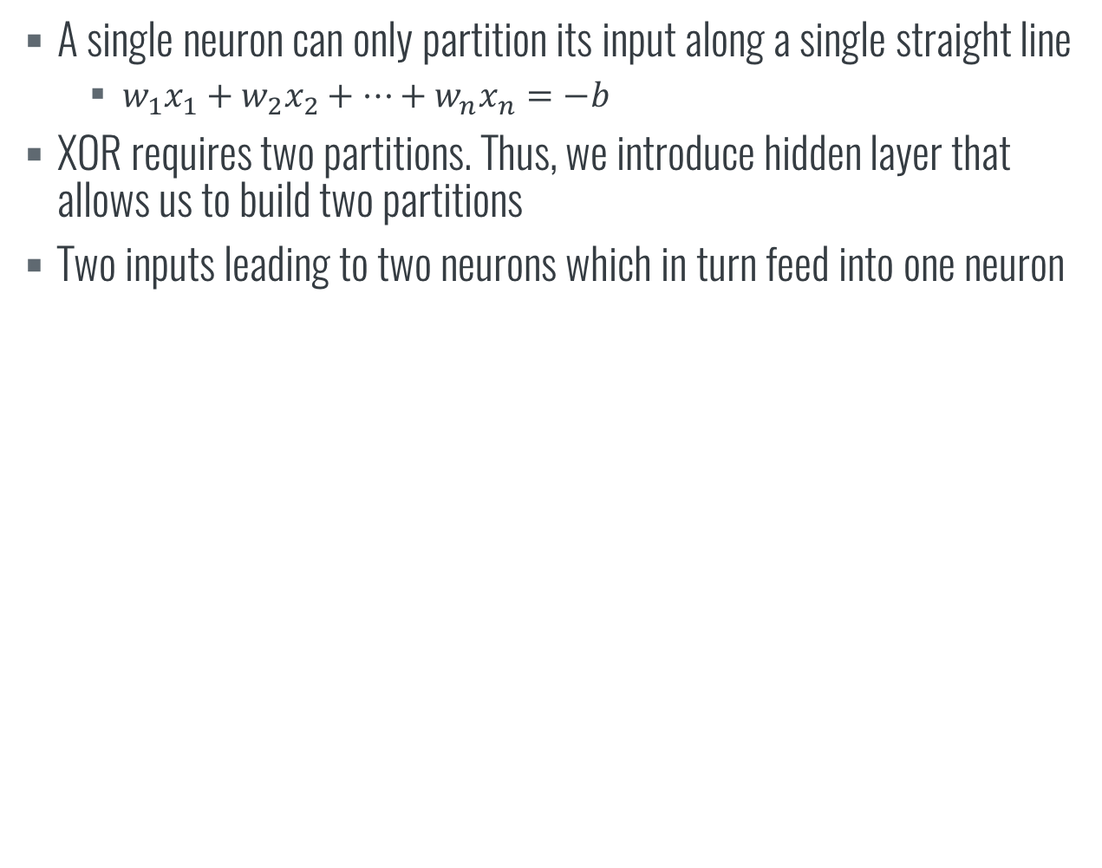
XOR FUNCTION
A single neuron can only partition its input along a single straight line
$w_{1}x_{1}+w_{2}x_{2}+…+w_{n}x_{n}=−b$
XOR requires two partitions. Thus, we introduce hidden layer that allows us to build two partitions
Two inputs leading to two neurons which in turn feed into one neuron

Slide 15
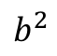
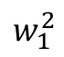
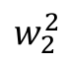
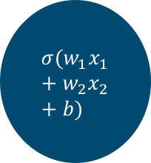
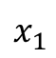
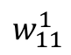
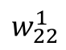
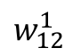
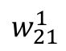
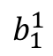
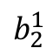
XOR FUNCTION
Two inputs leading to two neurons which in turn feed into one neuron
Total of 6 weights and 3 biases
$$σ(w_{1}x_{1}+w_{2}x_{2}+b)$$
$$x_{1}$$
$$w_{11}^{1}$$
$$w_{1}^{2}$$
$$σ(w_{1}x_{1}+w_{2}x_{2}+b)$$
$$w_{21}^{1}$$
$$b_{1}^{1}$$
a
$$w_{12}^{1}$$
$$σ(w_{1}x_{1}+w_{2}x_{2}+b)$$
$$w_{2}^{2}$$
$$b^{2}$$
$$x_{2}$$
$$w_{22}^{1}$$
$$b_{2}^{1}$$

Slide 16
XOR FUNCTION
Matrix notation
At 6 weights and 3 biases, we are already starting to see lots of lines of math showing up.
However almost all of them follow a similar pattern. We can use matrix notation to combine weights and bias in each layer into a single matrix that we can use for computation
We also use backpropagation. A shortcut where we use gradients in the forward layer to compute gradients for the layer behind.

Slide 17
DIGIT CLASSIFIER
Classification of MNIST handwritten digits
Famous dataset used for testing effectiveness of various ML algorithms
Input is a 28x28 grayscale image which we can take as a single vector of length 28*28 = 784.
50000 training cases, 10000 validation cases, 10000 test cases
Luckily, we have already created a matrix method to train a neural network
We can just set a different matrix size

Slide 18
DIGIT CLASSIFIER
Hyper-parameters
Learning rate of 3
Mini-batch size of 10
More frequent updates leading to better convergence
Randomly chosen
30 hidden layers
15 epochs (number of runs through total training data)
To limit time spent
Hyper-parameters are determined by running trials on various combinations to find the best performance.

Slide 19
CONCLUSION
We have seen neural networks which are classifiers that can work on a large range of problems
Simple to learn the basics
Deep neural networks are hard to train due to vanishing gradient problem
Use more novel strategies
Convolutional neural networks
Restricted Boltzmann machines
Recurrent neural networks
Basics remain the same

Slide 20
TO LEARN MORE
Neural Networks and machine learning http://neuralnetworksanddeeplearning.com/
Deep learning book http://www.deeplearningbook.org/
Neural Networks for Machine Learning https://www.coursera.org/learn/neural-networks
Digit classification on TensorFlow https://www.tensorflow.org/get_started/mnist/beginners

Slide 21
THE END

